Slide 1
Breast Cancer Detection and classification from Mammogram images based on GMM Segmentation and GLCM-DWT feature extraction and PNN Classification
PRABIR KUMAR DAS SHIVANI SINGH
ROLL – 20MM62R02 Roll - 20MM61R10
M-TECH in Medical Imaging and Informatics M-Tech in Biomedical Engineering

Slide 2
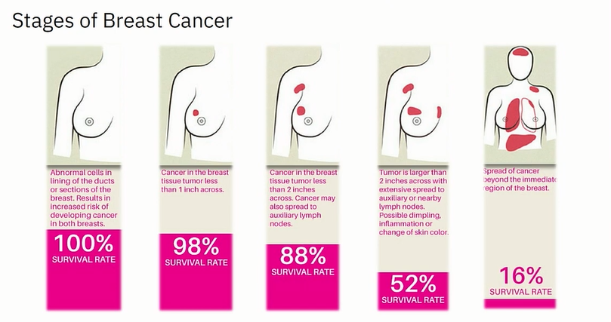

Slide 3
EARLY DETECTION SAVES LIVES…

Slide 4
Objectives
Our objectives in this project are to –
pre-processing and noise removal of breast mammogram images
segment the images to identify Region of Interests (ROI) using Machine Learning techniques
extract useful feature information using GLCM, DWT and finally
classify the images into three categories after its detection using PNN - Normal, Malignant, Benign.

Slide 5
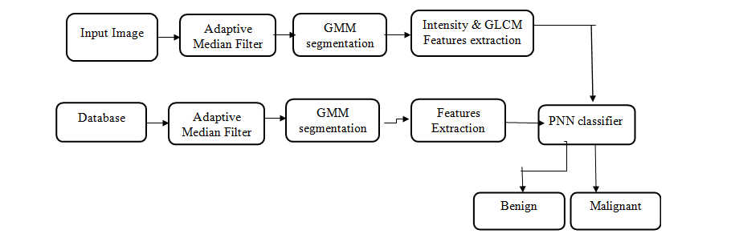
Our Project :

Slide 6
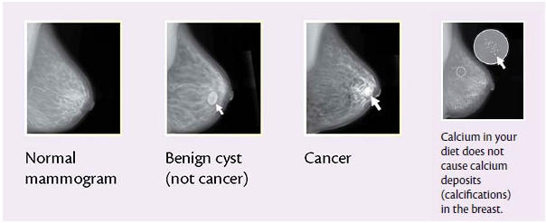

Slide 7
IMAGE DATABASE
University of South Florida Digital Mammography Home Page
http://www.eng.usf.edu/cvprg/Mammography/DDSM/thumbnails/normals/normal_02/overview.html
Images containing suspicious areas have associated pixel-level "ground truth" information about the locations and types of suspicious regions. Also provided are software both for accessing the mammogram and truth images and for calculating performance figures for automated image analysis algorithms.
Dataset 2 : University of South Florida :Digital Mammography /Home Page http://www.eng.usf.edu/cvprg/Mammography/DDSM/thumbnails/normals/normal_0 2/overview.html Images containing suspicious areas have associated pixel-level "ground truth" information about the locations and types of suspicious regions. Also provided are software both for accessing the mammogram and truth images and for calculating performance figures for automated image analysis algorithms.

Slide 8
Image Pre-Processing
Contrast Enhancement
Noise Removal

Slide 9
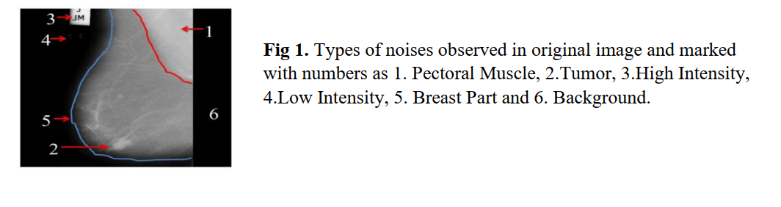

Slide 10
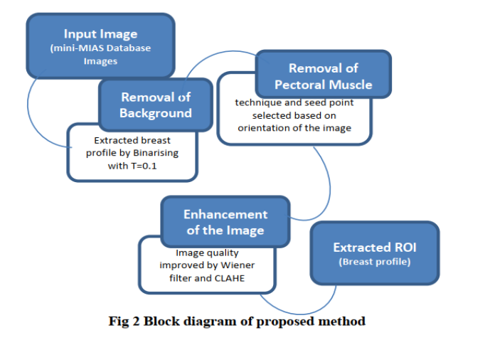

Slide 11
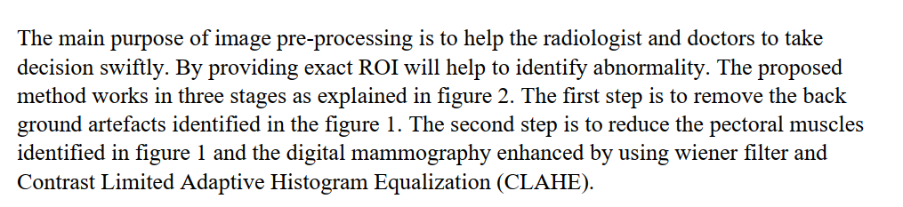

Slide 12
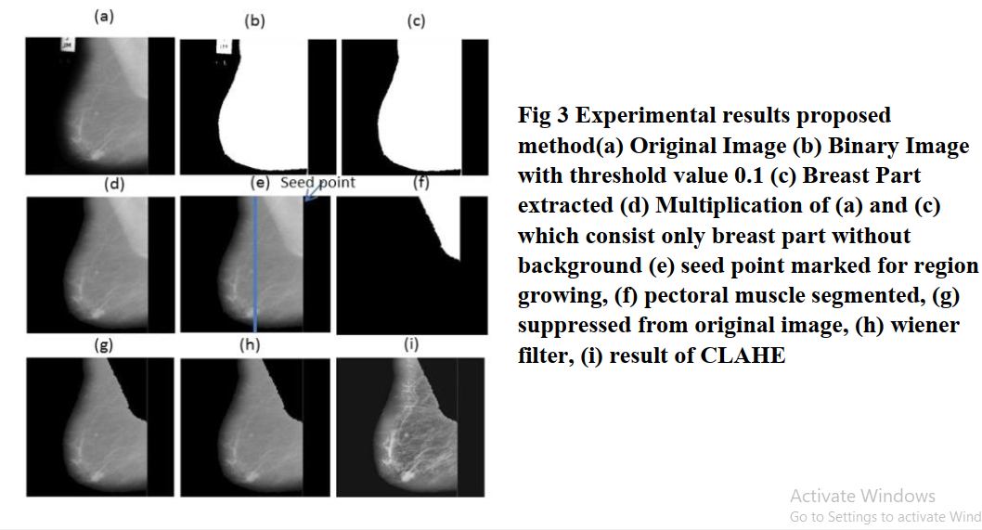

Slide 13
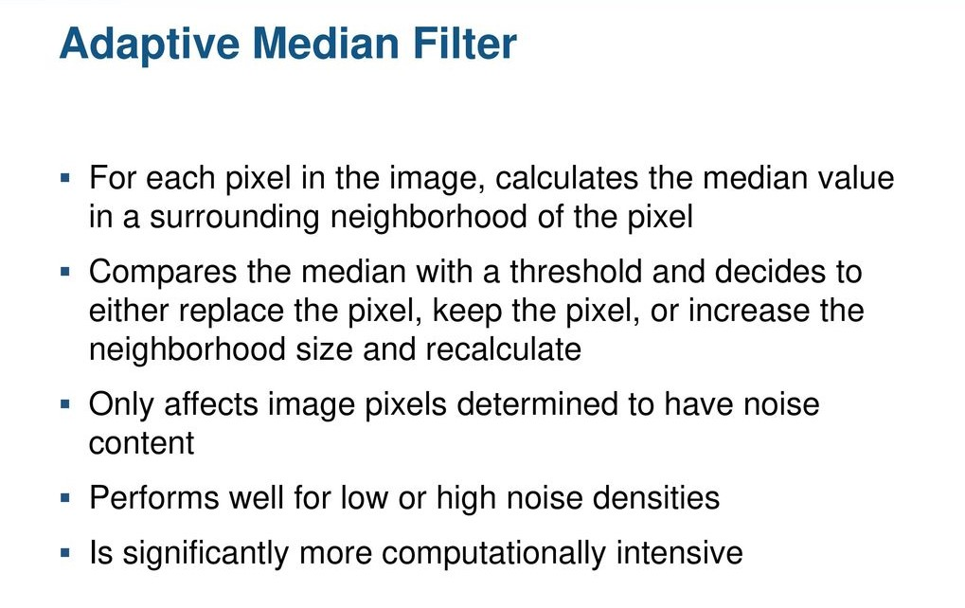

Slide 14
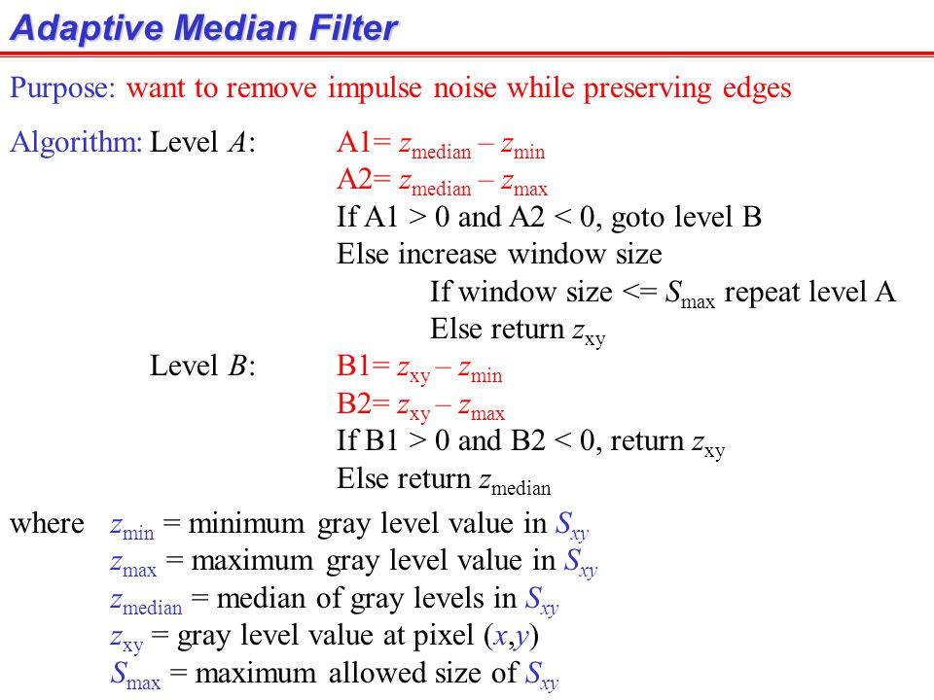

Slide 15
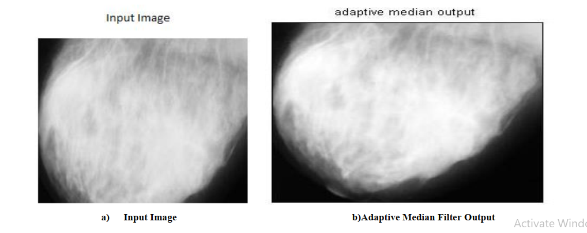

Slide 16
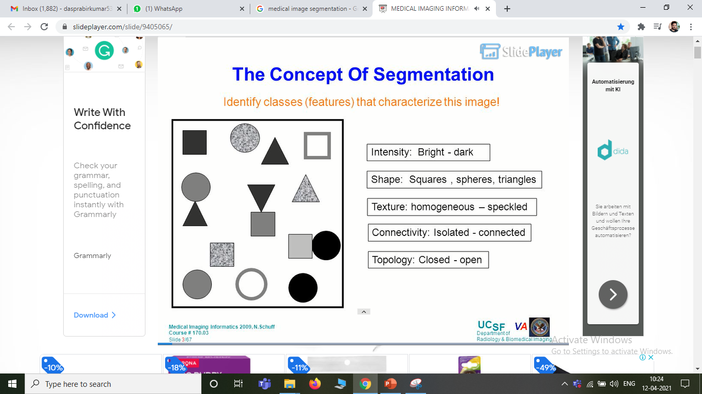

Slide 17
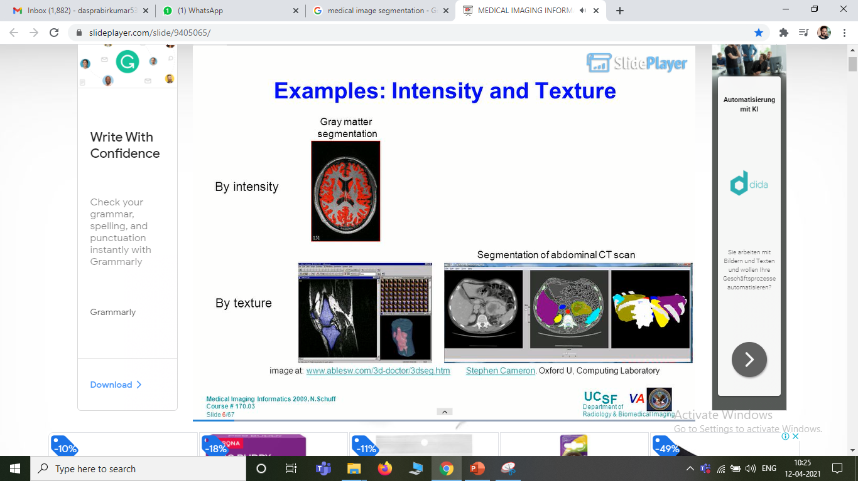

Slide 18
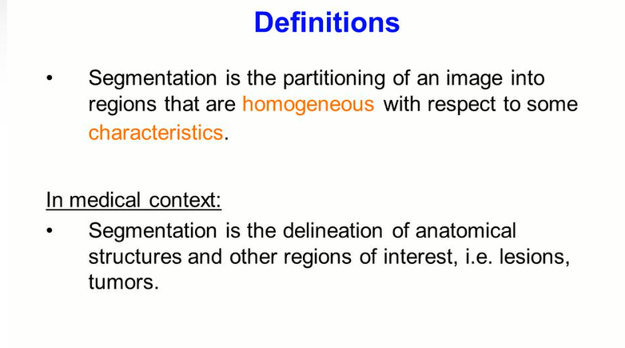

Slide 19
Image Segmentation using Machine Learning
K-MEANS CLUSTERING ALGORITHMS
GAUSSIAN MIXTURE MODEL

Slide 20
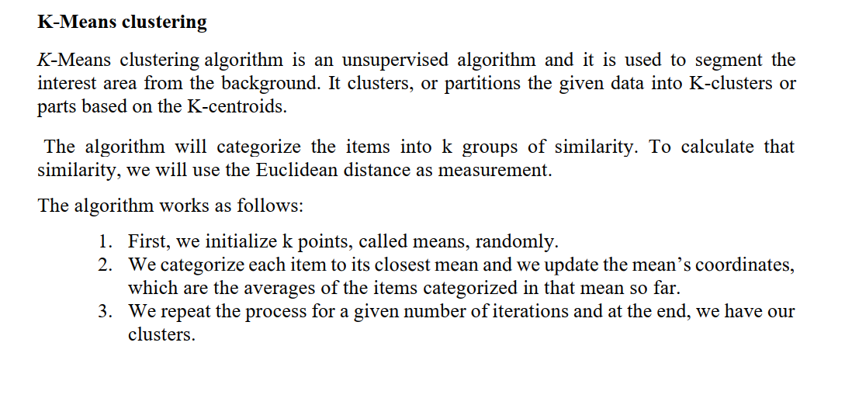

Slide 21
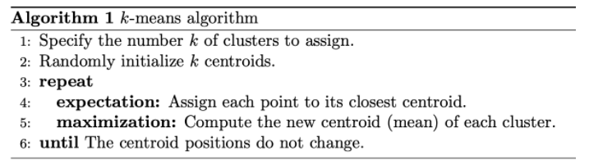

Slide 22
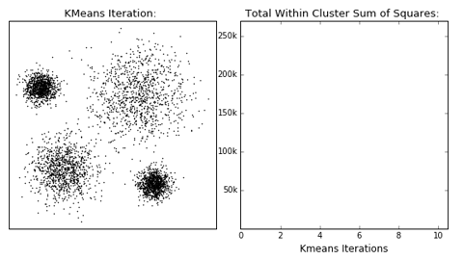

Slide 23
K-Means … HARD CLUSTERING
GMM … SOFT CLUSTERING

Slide 24
Gaussian Mixture Model
A Gaussian mixture model is a probabilistic model that assumes all the data points are generated from a mixture of a finite number of Gaussian distributions with unknown parameters.
One can think of mixture models as generalizing k-means clustering to incorporate information about the covariance structure of the data as well as the centers of the latent Gaussians.

Slide 25
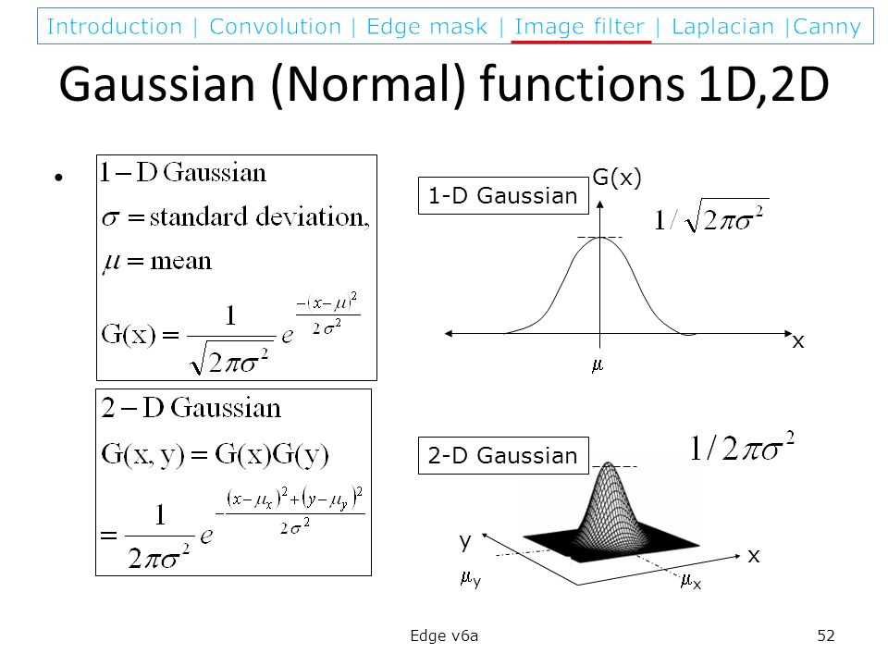

Slide 26
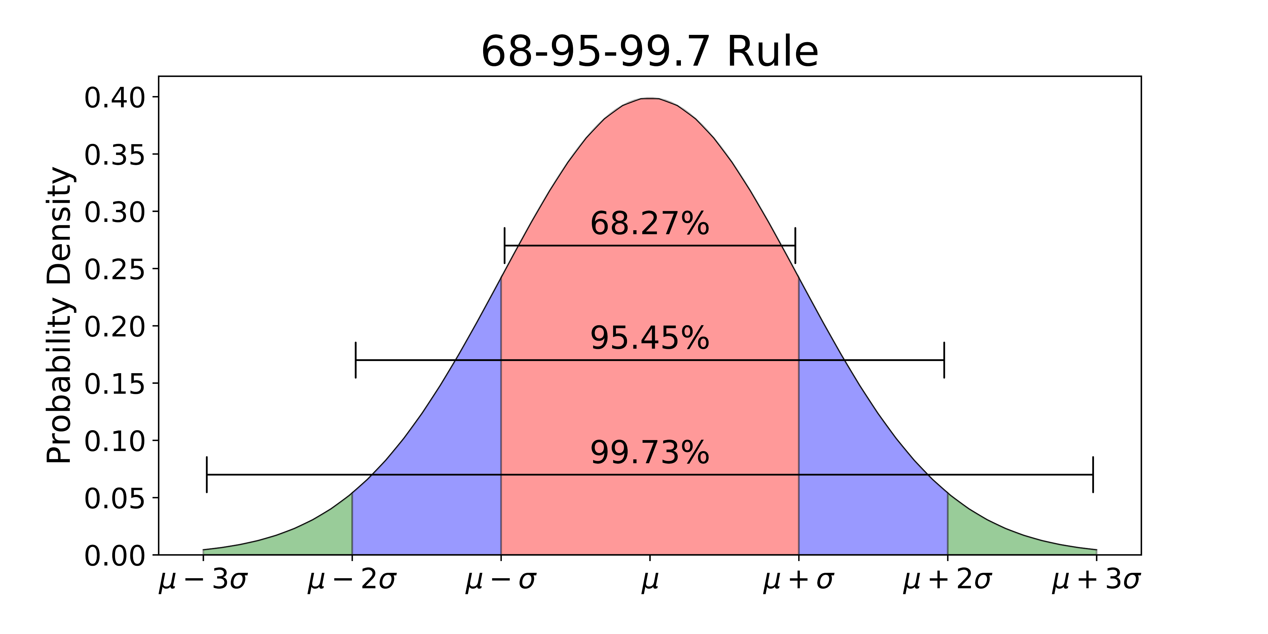

Slide 27
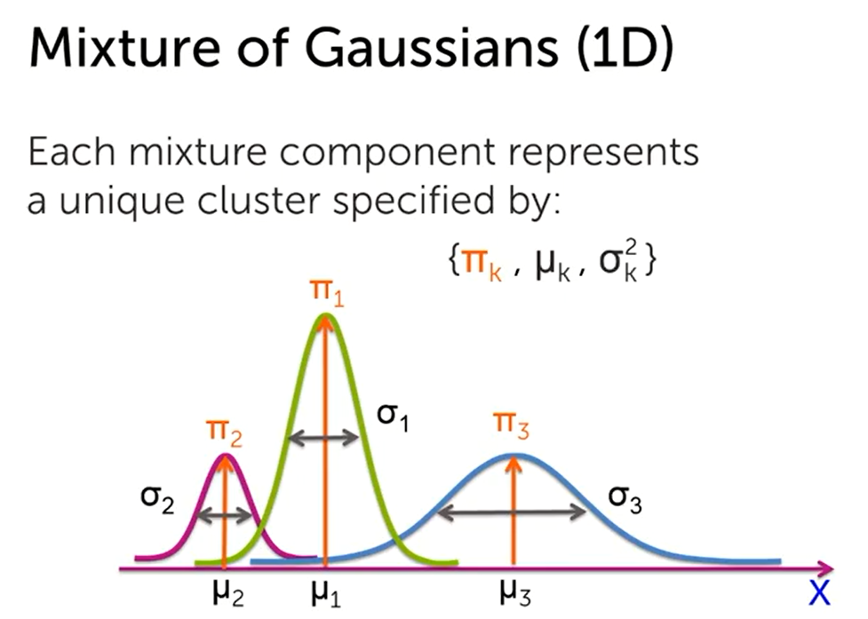

Slide 28
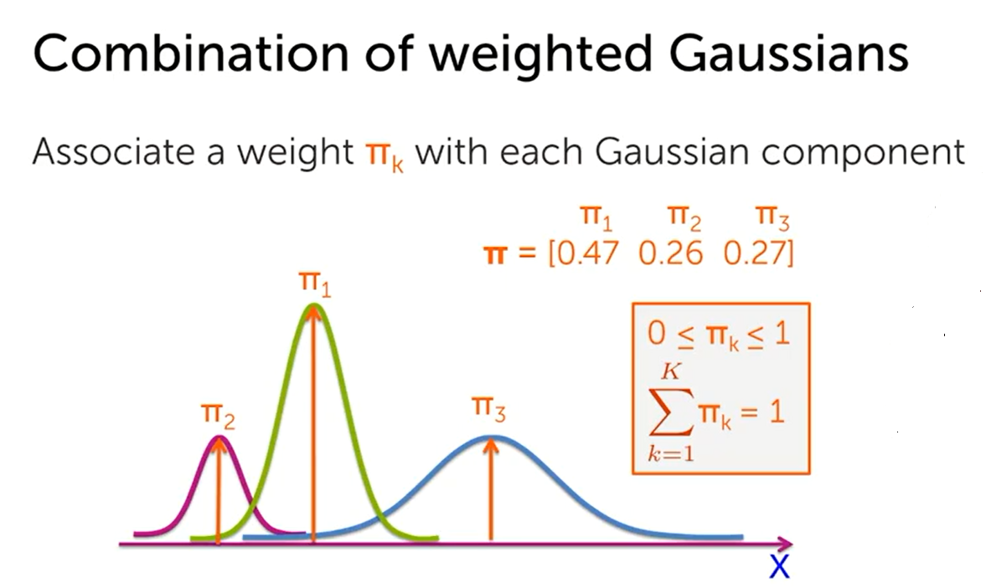

Slide 29
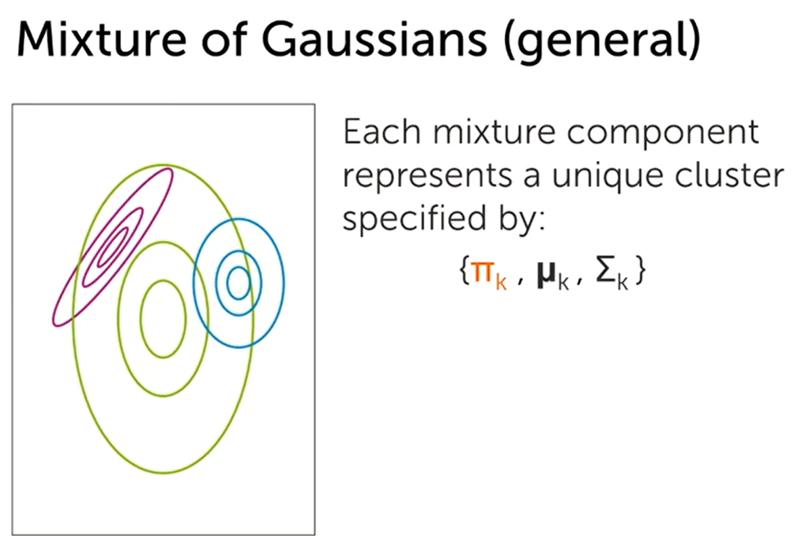

Slide 30
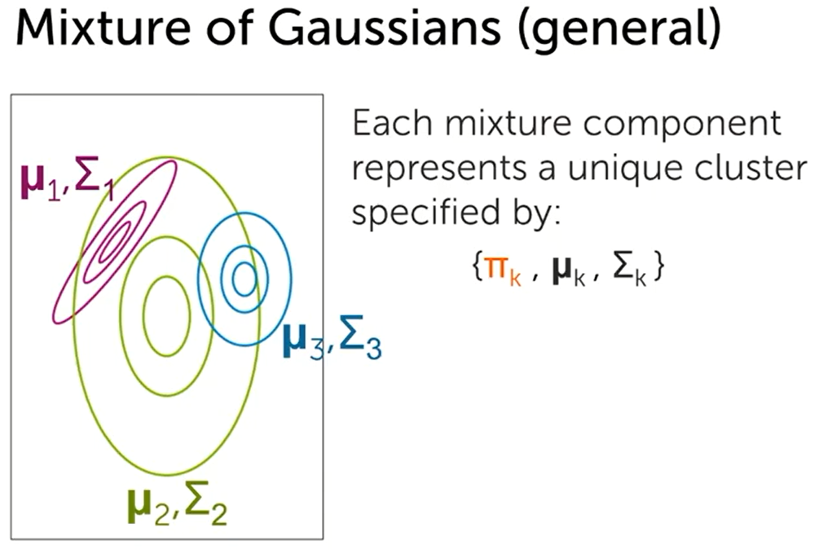

Slide 31
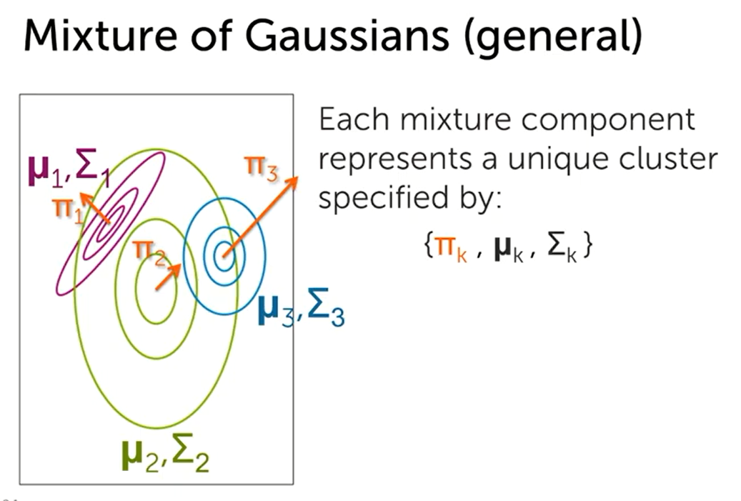

Slide 32
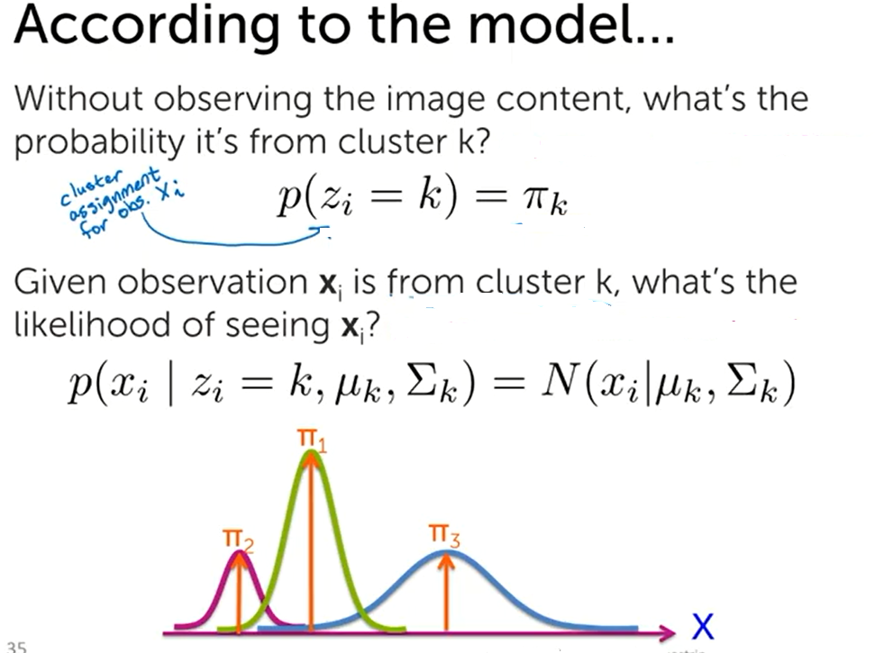

Slide 33
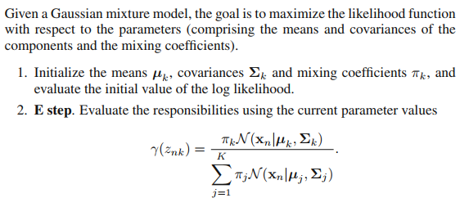

Slide 34
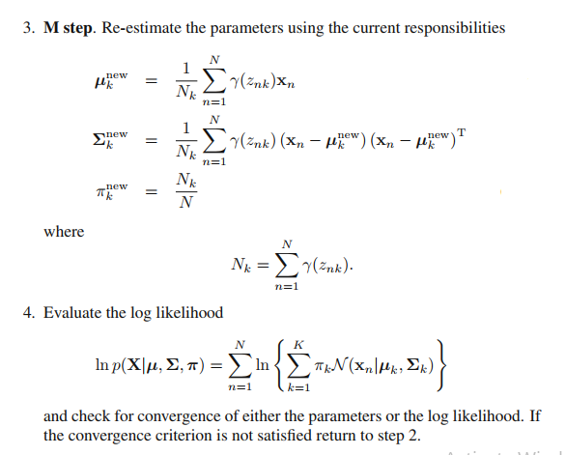

Slide 35
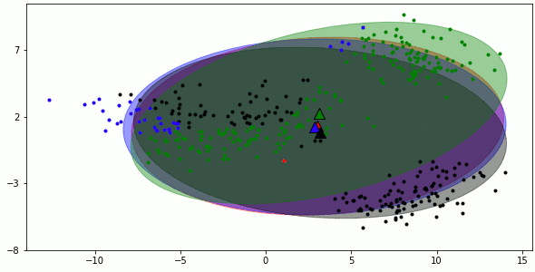

Slide 36
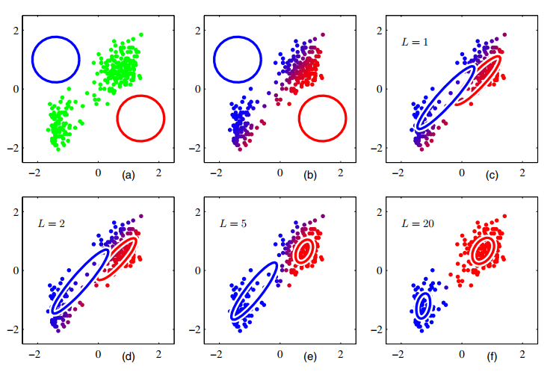

Slide 37
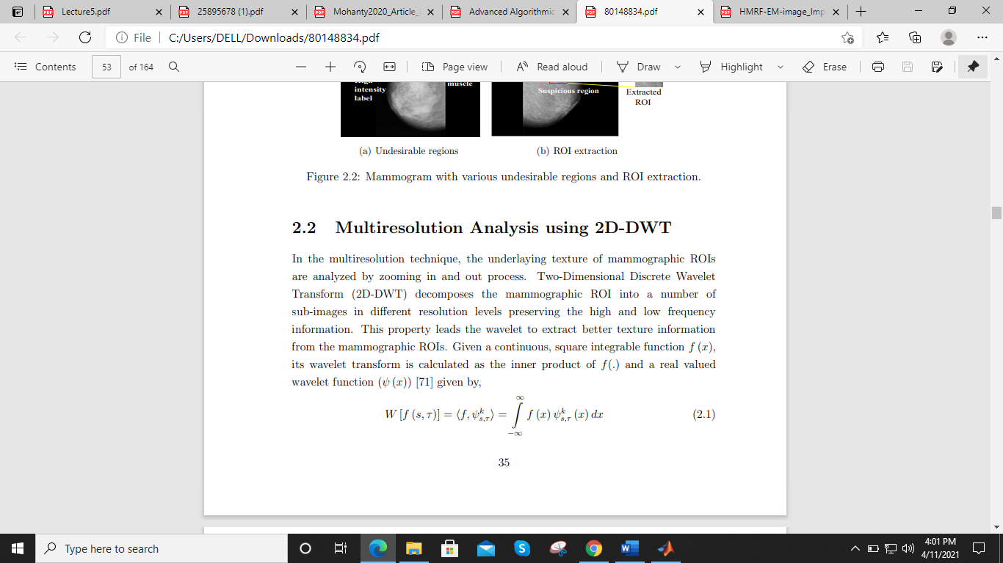
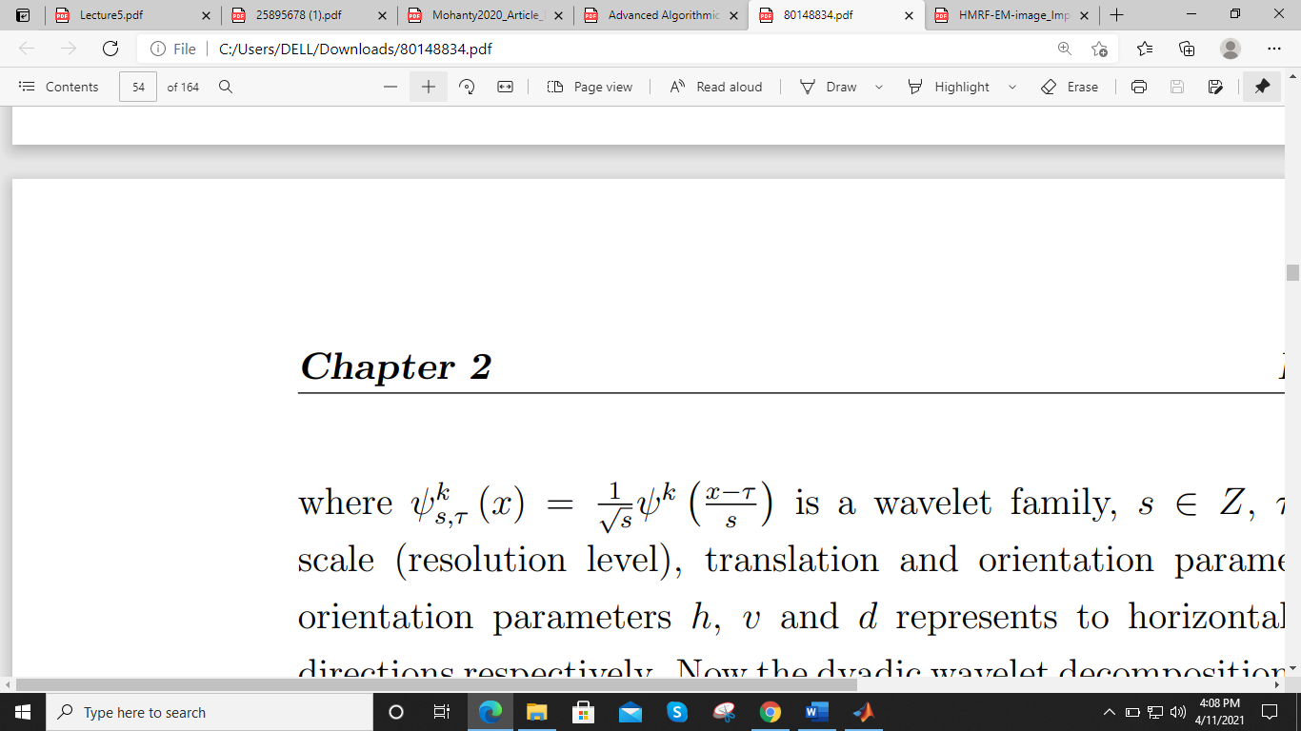
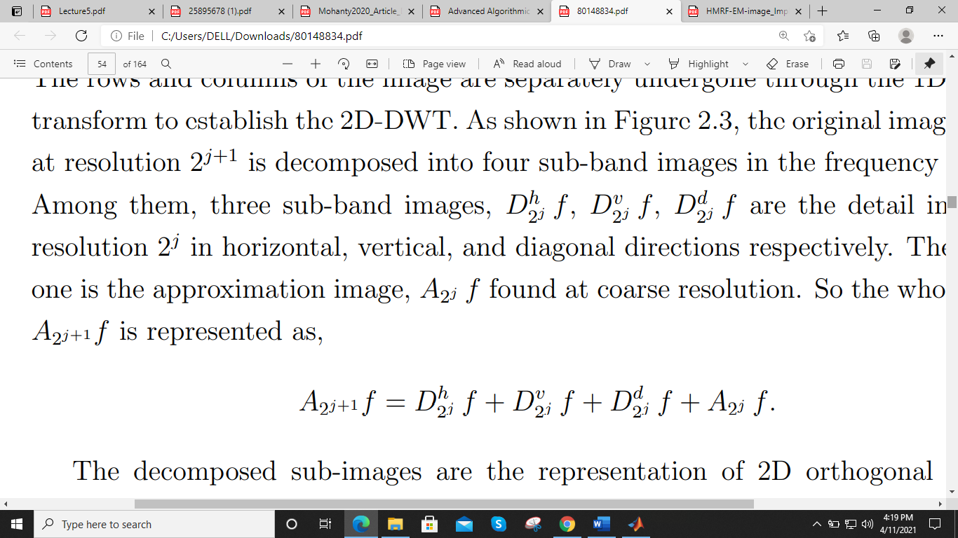
Feature Extraction
Discrete wavelet transform
Given a continuous, square integrable function f (x), its wavelet transform is calculated as the inner product of f(.) and a real valued wavelet function (ψ (x)) given by,
Here, S(scale) ∈ Z , T(translation) and k(orientation) ∈{h,v,d}
Here the orientation parameters h, v and d represent to horizontal, vertical and diagonal directions respectively.
detail images at resolution 2^j in horizontal, vertical, and diagonal directions respectively

Slide 38
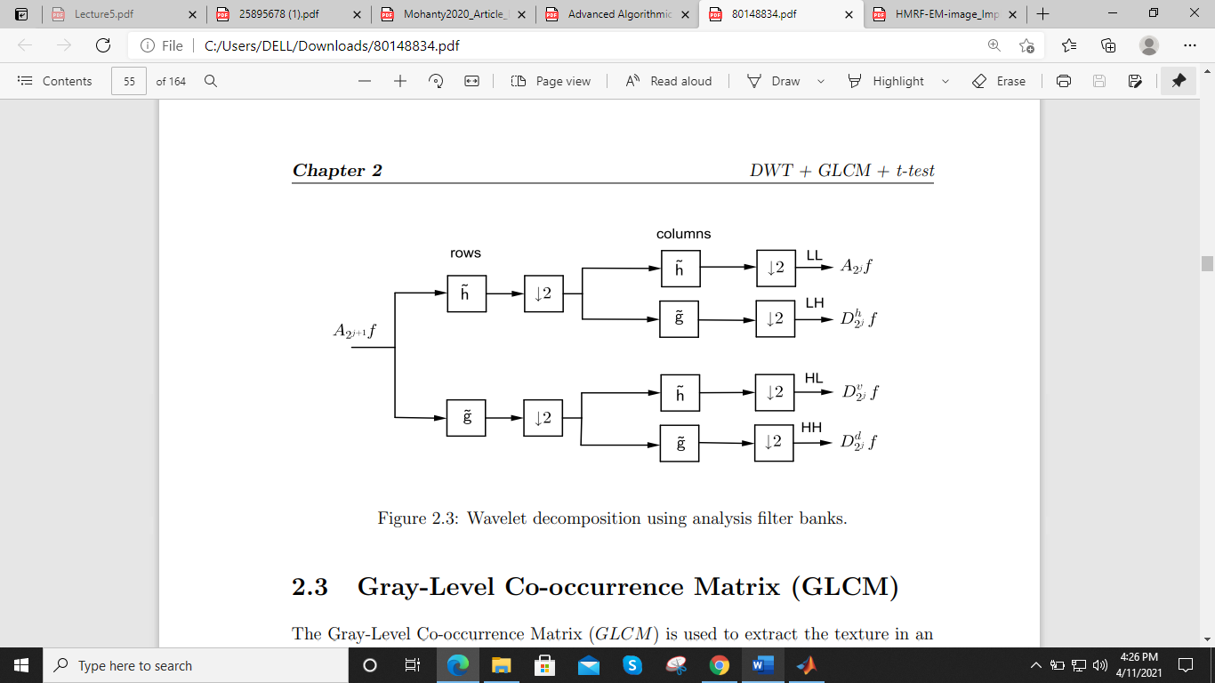
Wavelet decomposition using analysis filter banks filter banks.

Slide 39
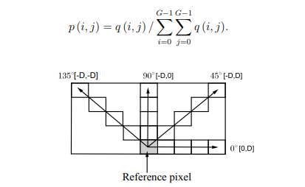
Gray level co-occurrence matrix (GLCM)
Normalized GLCM (NGLCM) is represented as:
Elements in q(i, j) in GLCM the represents sum of the frequency of occurrence of that pixel i in a certain association with the pixel j. It can be denoted as q(i, j | d, theta), where d is the distance of separation between the pixel pair i and j. The parameter theta stands for the orientation of the pixel i with respect to the pixel j.

Slide 40
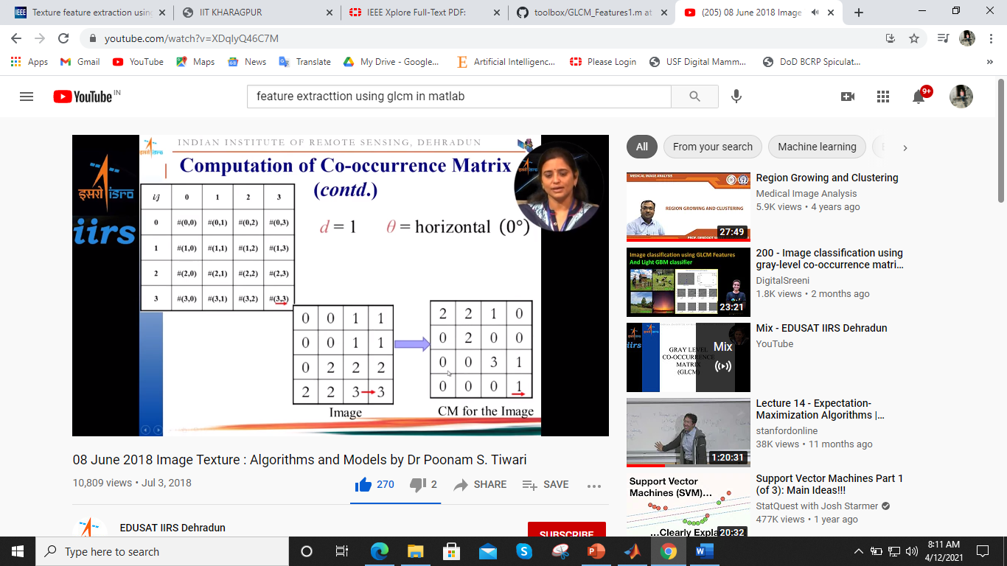
Computation of co-occurrence matrix(CM)

Slide 41
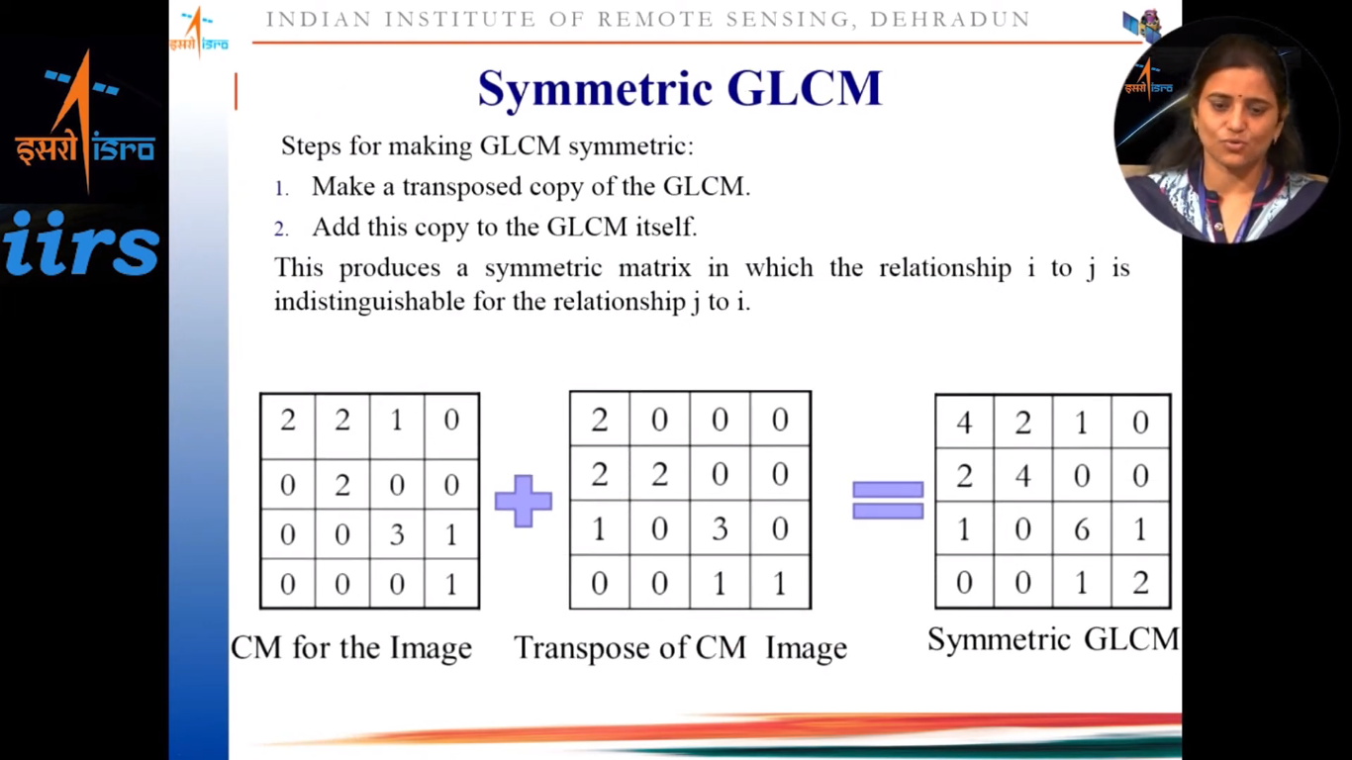
Symmetric GLCM

Slide 42
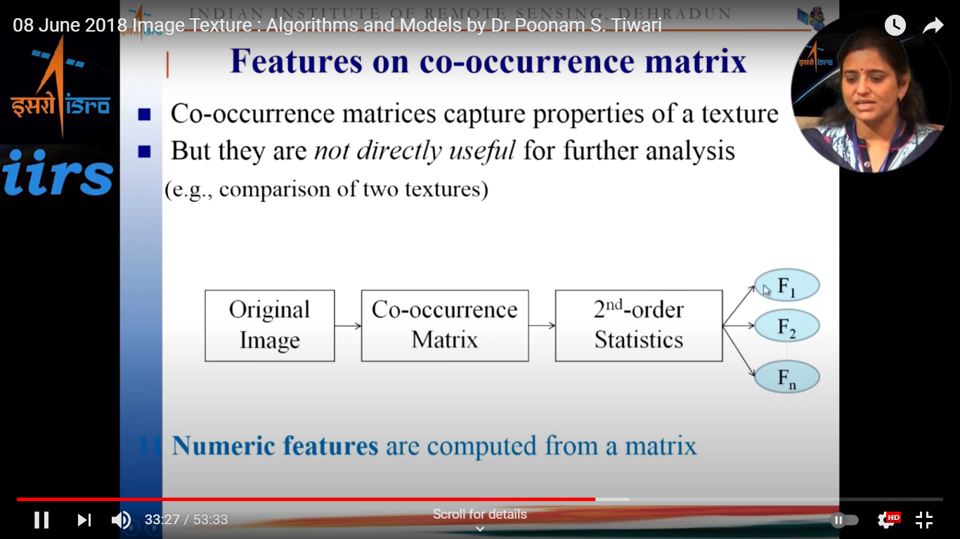
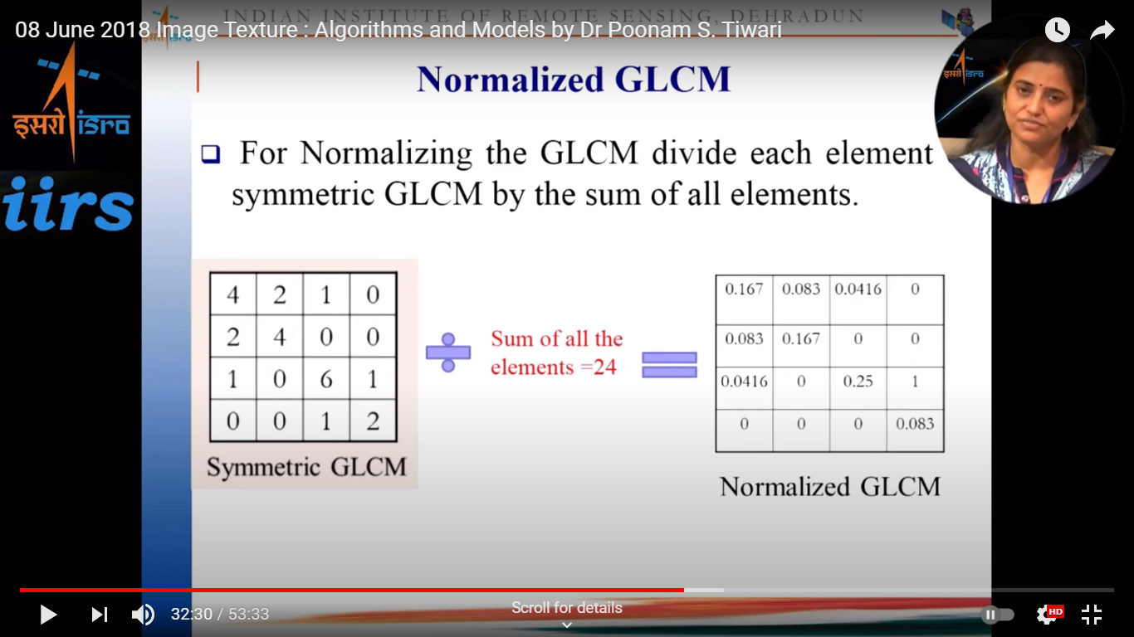
Features on co-occurrence matrix
Normalized GLCM

Slide 43
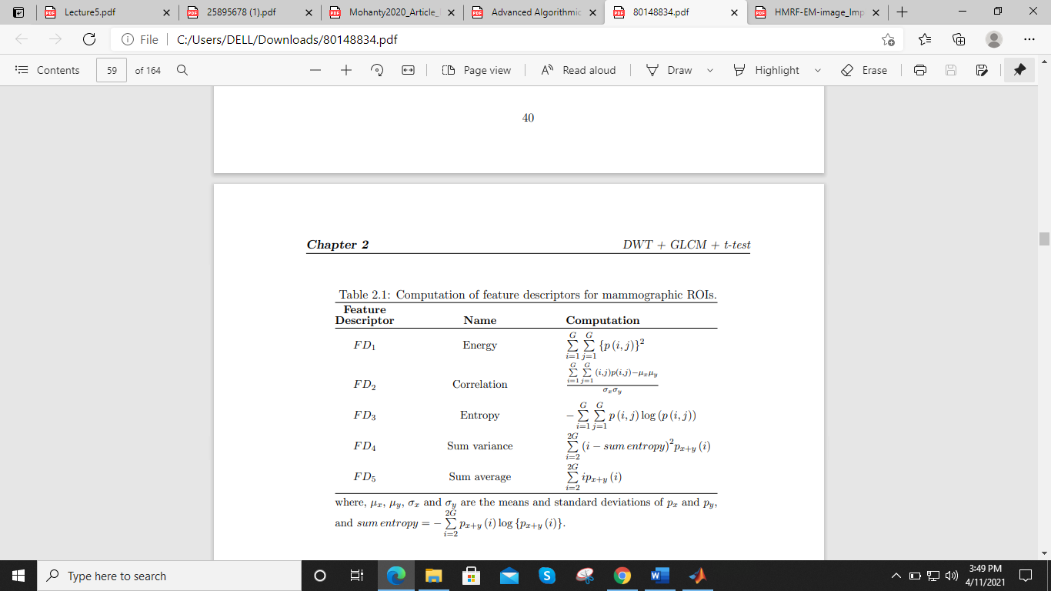
The feature descriptors to be derived from NGLCM for mammographic ROI can be mathematically represented as:

Slide 44
Feature Extraction using 2D-DWT and GLCM
On each of the mammographic ROIs the 2D-DWT is applied to capture the local information. Using the GLCM approach, the statistical measures or feature descriptor values are determined from the sub-bands of each of the blocks. at a set distance D. Then all the feature descriptors (F D) mentioned in Table are computed from each NGLCM and combined to form a feature descriptor matrix (F DM). Thus, a feature matrix is generated by concatenating all the FDMs from all NGLCMs for K number of ROIs.
Input segmented image
Image Decomposition by DWT
GLCM construction
Feature Extraction

Slide 45
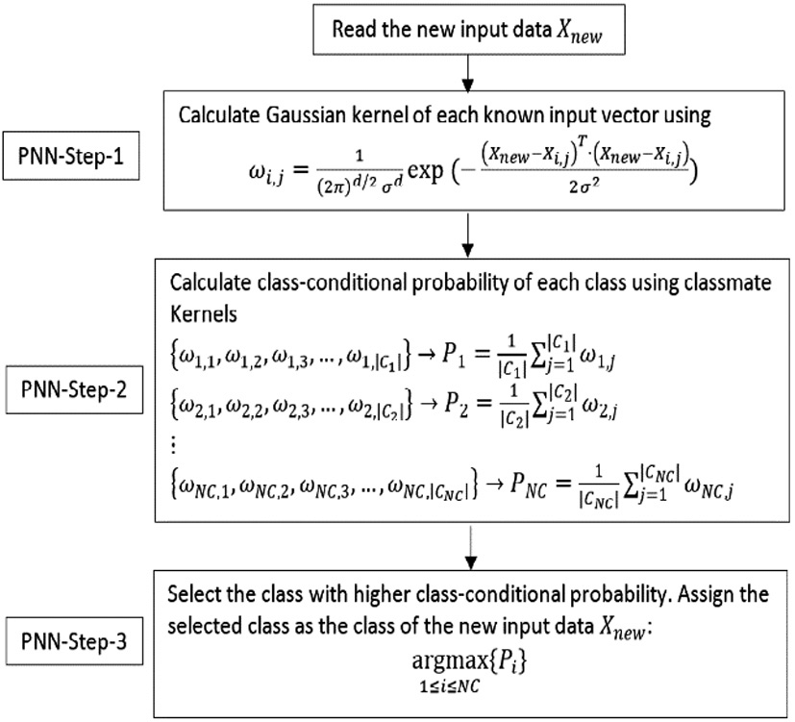
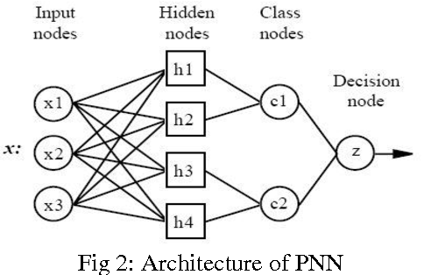
Probabilistic Neural Network

Slide 46
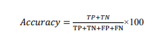
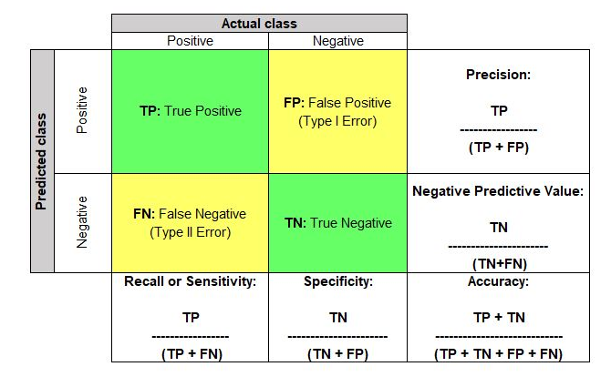
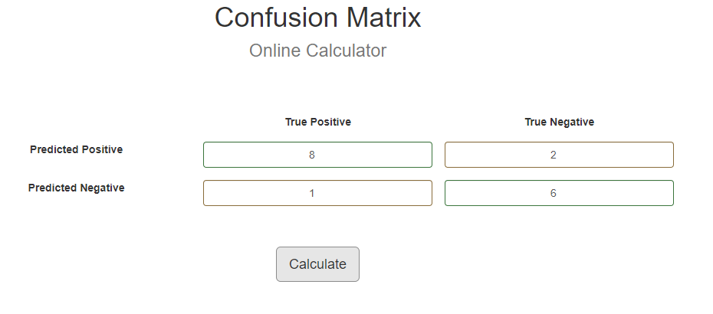
Results:
Now the performance of the proposed system is evaluated by considering the actual and predicted classification. Accuracy of the system is calculated by using the confusion matrix obtained for the classifier used. Table shows the confusion matrix for a two-class classifier. Classification accuracy, sensitivity, specificity, positive predictive value and negative can be defined by using the elements of the confusion matrix as. Classification accuracy: Accuracy of the classification is obtained by using the given equation:

Slide 47
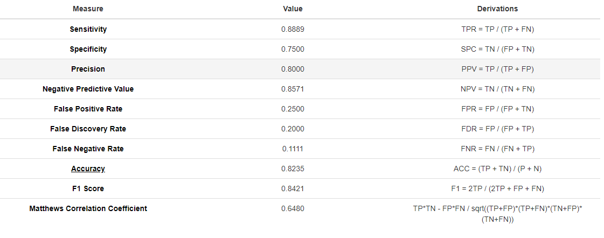
Our model performance:

Slide 48
Conclusion and Future Scopes
In this project, we did detection and classification along by segmentation and feature extraction of breast mammogram images. We built machine learning model and incorporate image processing techniques with it. We used 60 images for training our model and 17 images for testing. The accuracy calculated from confusion matrix is 82.35 % with F- score
84.21 %. The reason for low accuracy is less training and test data. Due to time constraint and less computing power, other resources we were not able to use large dataset. That is why our model got low accuracy.
In Future, we want to use more data and train our model with Convolutional Neural Networks (CNN) instead of PNN by incorporating new technology Deep Learning in our project.
Also, we can use more sophisticated image processing techniques for pre-processing and feature extraction.

Slide 49
References and Bibliography 1. Digital Image Processing Using MATLAB by Gonzalez and Woods , 2nd edition 2. Bishop - Pattern Recognition And Machine Learning - Springer 2006 3. PATTERN. CLASSIFICATION. Second Edition. Richard O. Duda. Peter E. Hart. David G. Stork. A Wiley-Interscience Publication. JOHN WILEY & SONS, INC. 4. Mammograms Classification using Gray-level Co-occurrence Matrix and Radial Basis Function Neural Network Mellisa Pratiwia , Alexandera , Jeklin Harefaa , Sakka Nandaa a Industrial Engineering Department, Faculty of Engineering, Bina Nusantara University Jl KH Syahdan 9, Jakarta 11480, Indonesia, mpratiwi@binus.edu 5. Mammogram classification method based on GMM and GLCM-PSO-PNN by Xiaojian Zhanga, Chengjian Weib and Xili Wanc School of computer science and technology, Nanjing Tech University, Nanjing 211816, China 6. Khoulqi, Ichrak & Idrissi, Najlae & Sarfraz, Muhammad. (2020). Segmentation of Pectoral Muscle in Mammogram Images Using Gaussian Mixture Model-Expectation Maximization. 10.4018/978-1-7998-4444-0.ch009. 7. A GLCM based Feature Extraction in Mammogram Images using Machine Learning Algorithms BN Jagadesh, L Kanya Kumari Professor, Department of Computer Science & Engineering, Srinivasa Institute of Engineering and Technology, Amalapuram, Andhra Pradesh, India; 2Assistant Professor, Department of Information Technology, Andhra Loyola Institute of Engineering and Technology, Vijayawada, Andhra Pradesh, India. 8. Abirami C, Harikumar R, Chakravarthy SRS. Performance analysis and detection of microcalcification in digital mammograms using wavelet features. International Conference on Wireless Communications, Signal Processing and Networking.2016; 2327-2331. 9. Nagarajan V, Britto EC, Veeraputhiran SM. Feature extraction based on empirical mode decomposition for automatic mass classification of mammogram images. Med Novel Tech Devic 2019;1:100004 10. Rangayyan M, El-Faramawy NM, Desautels JEL Alim OA. Measures of acutance and shape for classification of breast tumours. IEEE Transactions Med Imaging.1997;16:799-810.

Slide 50


